Slide 1
OLIST
STORE
ANALYSIS

Slide 2
OLIST STORE
Spread across 4 continents.
3095 sellers and 99441 customers.
Total sales of $16.01 M.
71 varieties of products
High customer satisfaction

Slide 3
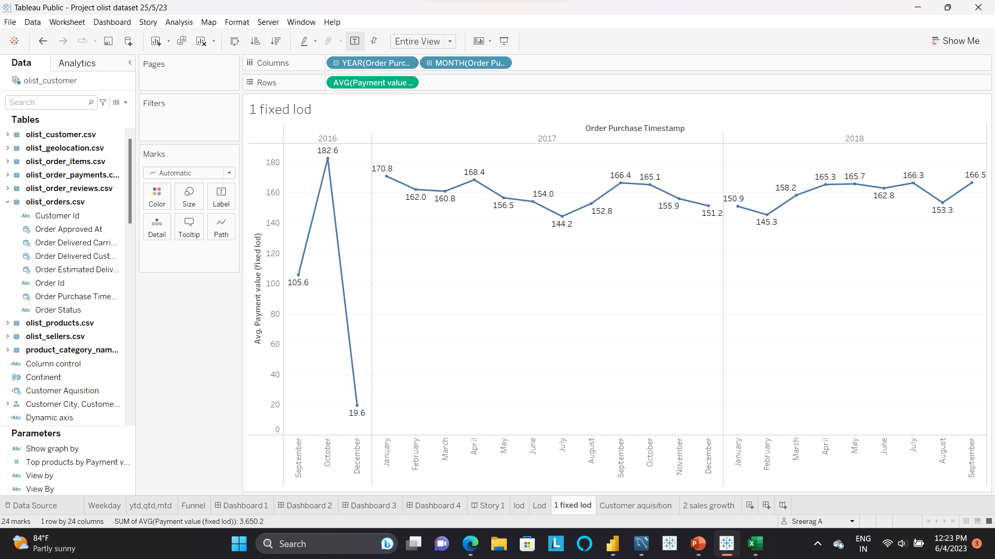
Sales Analysis
Total revenue – $ 16.01 M.
Avg Sales per day $154.10
Sales growth in last year is 22.54 %
Avg sales decreases in first half of 2017 and then increase.
It again decreases until 2018 February and is stable after that.
Highest sales avg – 182.6 in October 2016. High sales of home & furniture.
Lowest sales avg – 19.6 in December 2016. Only fashion & accessories.

Slide 4
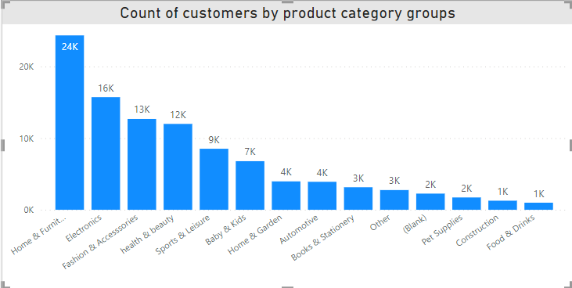
Customer Analysis
Majority are located in South America (89.1 %).
About 2965 (≈ 3%) customers didn’t purchase any products.
Customer growth rate in last year is 21.9 %.
Customer retention is very low. Almost all of them purchased in one year only.
Year | Total Orders | Unique Purchase | Repeat Purchase | Payment Value
2016 | 289 | 272 | 17 | 59362.34
2017 | 45648 | 43355 | 2293 | 7249746.73
2018 | 54818 | 52849 | 1969 | 8699763.05
Total | 100755 | 96476 | 4279 | 16008872.12
SP state is largest contributor of the revenue, consisting of 41.75 K customers and a total payment value of $ 6 M.

Slide 5
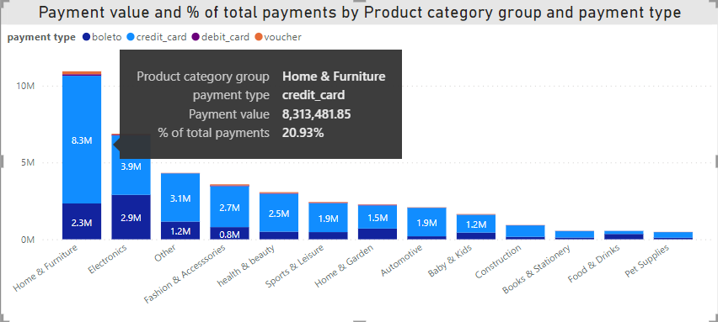
Sellers Analysis
Majority of sellers are from South America (92.31%).
Average seller rating is 4.09 out of 5.
Average selling price is $ 120.65.
Most selling category is home & furniture.

Slide 6
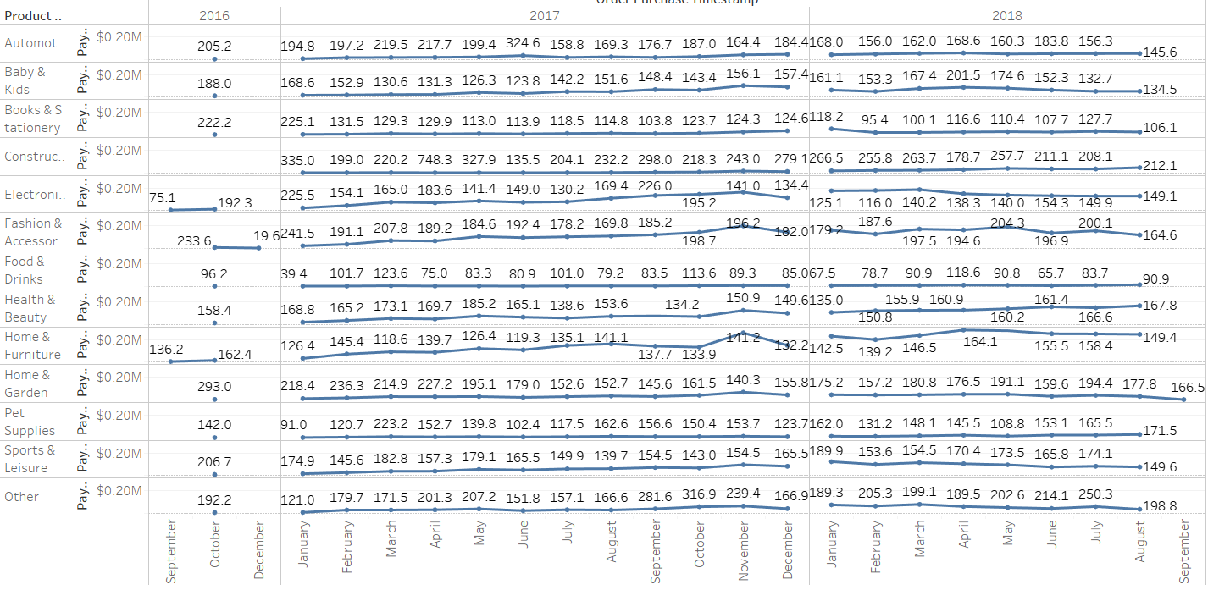
Product Analysis
Home & Furniture generate most revenue of $ 10.9 M (68%)
Selling construction products is not profitable (avg price 158).
Several categories showed critical jump in sales in Nov 2017.
February 2018 showed considerable drop in sales of some products.

Slide 7
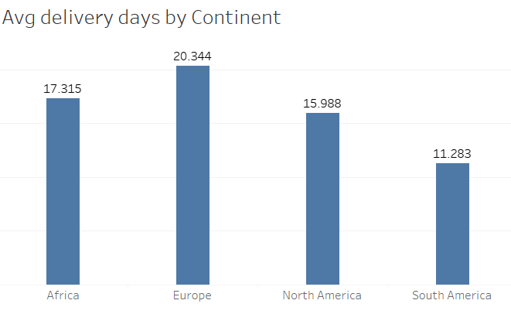
Shipping & Delivery
Review score is affected by shipping delay.
Freight value is proportional to product volume (CR – 0.87)
Product volume affects the shipping days in some cases.
Out of 99.44 K orders 96 K are delivered which yields a delivery success rate of
97 %.

Slide 8
Operational Efficiency
Order fulfillment rate – 97.02 %.
Average delivery time – 12.14 days.
Shortage of sellers in Europe and Africa affects the sales.
Need to transport large products fast.

Slide 9
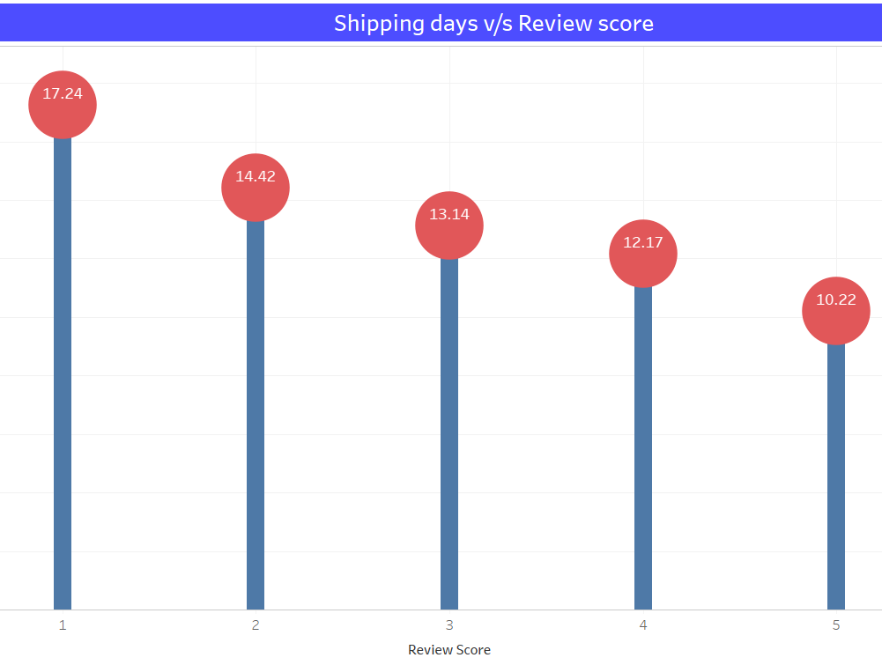
Customer feedback
Positive feedback ratio – 85.3 %.
Delay in shipping affects review score.
Cancelling products reduced from
7.9 % to 0.62 %.
Security and services is least rated.
Average customer rating increases from 3.54 to 4.09 over the years.

Slide 10
Recommendations & Conclusions
Recruit more sellers in Africa and Europe to meet customer needs.
Reduce the delay in shipping for large products.
Inform the unavailability of products as soon as possible.
Introduce methods to retain customers.
Store needs to expand into more regions.

Slide 11
Group Members
Mr. Adithya S Vasisht
Mr. Adnan Sakeer Kaloontakath
Mr. Hemanth S
Mrs. Rajalakshmi S T
Mr. Sreerag A

Slide 12
THANK YOU

